Slide 1

HUM111 Pakistan Studies
Lecture 07

Slide 2
HUM 111 Pakistan Studies
Lecture 07
India Act 1935 and Lahore Resolution
Dr. Sohail Ahmad

Slide 3

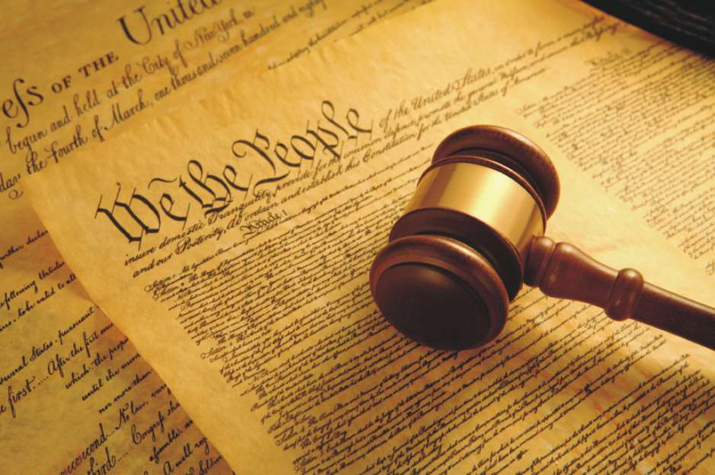
1935 Act

Slide 4
1935 Act [1/5]
Government of India Act -1935:
The Round Table Conferences could not achieve their objective and thus failed. However, on the suggestions of Round Table Conferences white paper was issued in 1933 and efforts were started to make the constitution of India.
A committee was setup under the chairmanship of Lord Linlithgow, the viceroy of India, to consider the recommendations of the white paper. The report of the committee was published in 1934 that was contained in a bill of law.
The report along with the bill was passed in the British Parliament. After the Royal assent the Act was enforced in the country as Government of India Act 1935.
The Government of India Act 1935 consisted of two parts. One part was central and the other part was the provincial.

Slide 5
1935 Act [2/5]
The following were the salient features of the Act:
The Act proclaimed a bicameral legislature. One house of the Assembly was called the Indian Legislature Assembly and the other house of the Assembly was The Council of State. The Council of State was the upper house that was a permanent body i.e. that it could not be dissolved like the lower house of the Parliament. One-third members of the upper house had to retire after every 3 years. The lower house of the Assembly, the Indian Legislature Assembly, was not an independent body. The laws passed by the Assembly could be vetoed by Governor-General. The legislature had no control over the legislation under this Act.
As regards the Federal Budget it was consisted of two parts. One part consisted of non-votable portion of the budget that was 80 % of the whole budget. This part of budget could not be discussed or amended in the legislature. The other part of the budget that consisted of 20% of the whole budget could be discussed or amended in the Federal Assembly.

Slide 6
1935 Act [3/5]
The provinces were given more authority and powers and for the first time the provinces were made separate entities.
Under the Act there were three lists of subjects. One was federal, 2nd was provincial and the 3rd was concurrent list.
The whole country was divided in to 11 provinces.
The Governor-General in the centre and the Governors in the provinces were given special rights and privileges. In case of emergency situation both Governor-General and Governors enjoyed unlimited powers and their authority could not be challenged in any institution.

Slide 7
1935 Act [4/5]
Under the Act a Federal Court was established. The court was consisted of Chief Justice and six other judges. After the age of 65 the judges of the Federal court had to vacant the seat however any judge of the court could leave his seat before the age of 65. The court could interpret the constitution and if Governor-General needed any help regarding the constitution matters the court was bound to give advise but it was totally depended upon him to accept or reject the advice.
Under the Act the Secretary of State for India enjoyed the same powers that the other ministers enjoyed under the Act.

Slide 8
1935 Act [5/5]
The Act of 1935 failed to win appreciation from various sectors.
Both the Muslim League and the Indian National Congress expressed their dissatisfaction over the Act.
Hindu leader Madan Mohan greatly criticized this Act and Pandat Jawahar Lal Nehru said on the emergency rights of Governor-General and Governors that this Act was like a machine that had strong brakes and no engine.
Muslim leader Muhammad Ali Jinnah termed this scheme thoroughly rotten, fundamentally bad and totally unacceptable.

Slide 9
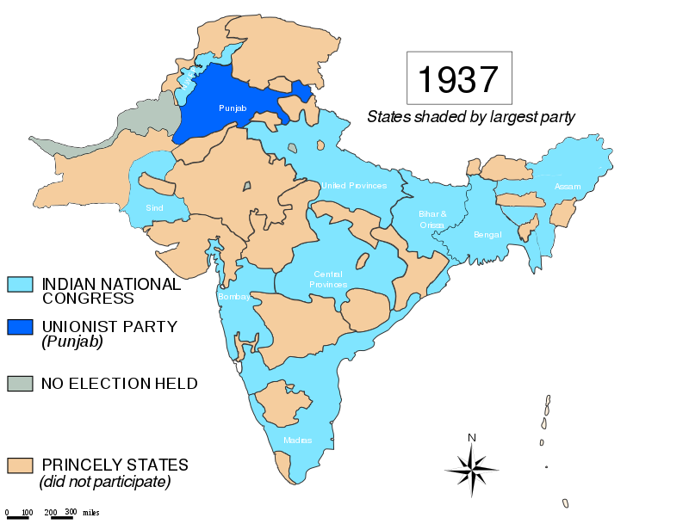
1936 Elections

Slide 10
1936 Elections
The Government of India Act of 1935 was practically implemented in 1937. The provincial elections were held in the winter of 1936-37.
There were two major political parties in the Sub-continent at that time, the Congress and the Muslim League.
Both parties did their best to persuade the masses before these elections and put before them their manifestos.
The political manifestos of both parties were almost identical, although there were two major differences. Congress stood for joint electorate and the League for separate electorates; Congress wanted Hindi as official language with Devanagri script of writing while the League wanted Urdu with Persian script.
According to the results of the elections, Congress, as the oldest, richest and best-organized political party, emerged as the single largest representative in the Legislative Assembles. Yet it failed to secure even 40 percent of the total number of seats.

Slide 11
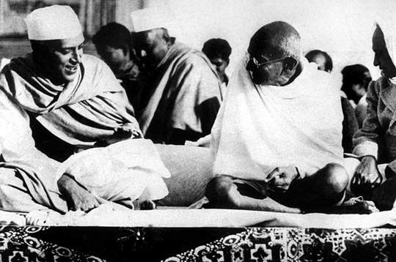
Congress Rule (1937-1939)

Slide 12
Congress Rule (1937-1939)
The congress rule was oppressive towards the minorities especially Muslims.
They started ‘Muslim Mass Contact’ movement to defame the ML in their favour.
They were making cultural and educational policies that promoted the Hindu culture and symbols in the name of Indian culture.
They introduced Banda-Mataram anthem in the institutions and offices etc.
The Hindi language was given top most importance in their policies
Wardha Educational Scheme was to convert Muslims into Hindus through primary educational literature
Projection of Hindu heroes like Gandhi and distortion of Muslim history became their moral creed.
followed the policy of discrimination in services or new recruitment for jobs.

Slide 13
Congress Rule (1937-1939)
The Congress ministries adopted overall negative and cruel attitude, especially towards the Muslim activists.
This unjust treatment compelled the Muslims to be disciplined in every sphere of life

Slide 14
Muslim Response to Congress Rule

Slide 15
Muslim Response to Congress Rule
The Muslims were well aware of the theocratic inclination of the Hindu people.
They arranged a close monitoring of the government.
They publicized their policies and raised the issues.
The mobilization of Muslims on these matters required keen probe to collect the original facts of the Hindu atrocities.

Slide 16
Muslim League Activism
The Muslim League highlighted the issues and mobilized the Muslims to counter them adequately.
It reorganized the Muslim community to cope with the situation.
The Muslim leaders shed a sharp criticism on the Congress policies
They protested against the reduction of status of Urdu and other Muslim related issues.
They created realization, amongst the Muslims, of what can happen under the Congress rule and urged for serious thinking about the future political and constitutional arrangements.
They unearthed the real objectives of the Congress and urged the need of unity among the Muslims under the banner of Muslim League.
The Pirpur Report (November 1938)
The Sharif Report (March 1939)
The Fazl-ul- Haq Report (December 1939)

Slide 17
Congress Rule (1937-1939)
The congress rule was oppressive towards the minorities especially Muslims.
The Congress ministries resigned in October and November 1939, in protest against Viceroy Lord Linlithgow's action of declaring India to be a belligerent in the Second World War without consulting the Indian people.

Slide 18
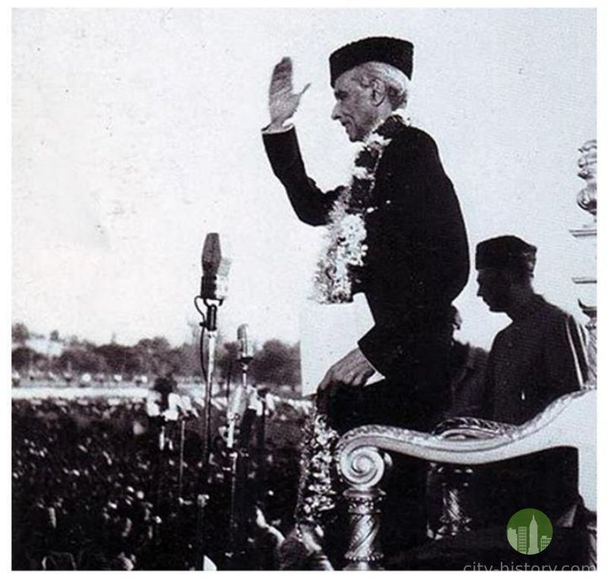
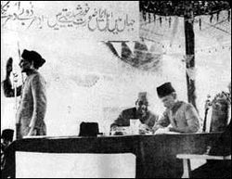
Lahore Resolution

Slide 19
Lahore Resolution
With the clarity of mind and backing of the Muslim community behind him, Quaid-i-Azam called for the 27th annual session of All India Muslim League to be held from March 22 to 24, 1940 at Lahore.
The Lahore Resolution of 1940 is a significant document. It’s a document of primary importance in the history of Pakistan.
The resolution signified a change of direction of the Muslim Movement. It identified a new destination, it was basically a change of strategy.
Previously, the talks were for Federalism, provincial autonomy, constitutional safeguards and guarantees.
In Lahore Resolution Muslim League officially talked about separatism, a separate state or the partition of India. This was something which they thought was needed for achieving the primary goal and that was the protection and promotion of Muslim identity and Muslim interests in the Indo-Pak Sub Continent.

Slide 20
Hindu Reaction
The Hindu reaction was, of course, quick, bitter and malicious. They called the “Pakistan” demand “anti-national.”
They characterized it as “vivisection; above all, they denounced it as imperialist – inspired to obstruct India’s march to freedom”.
In denouncing the demand outright, they, however, missed the central fact of the Indian political situation; the astonishingly tremendous response of the Pakistan demand had elicited from the Muslim masses.

Slide 21
British Reaction
The British were equally hostile to the Muslim demand for at least two important reasons.
First, they had long considered themselves as the architects of the unity of India and of an Indian nation.
Second, they had long regarded the super-imposed unity under Pax Britannica as their greatest achievement and lasting contribution in history.
The Pakistan demand threatened to undo these presumed achievements on which the British had long prided.

